Slide 1
Go Recon Yourself! 2.0
Discovering your external risk using mostly open source tools. UPDATED AND SCARIER THAN EVER.

Slide 2
Just unplug the internet cord and start a farm.
Informal Title

Slide 3



Thank You

Slide 4
Disclaimer:
This presentation is for informational purposes ONLY. The conference organizers nor myself are responsible for any malicious behavior.

Slide 5
Today’s Agenda
1. Estimated Time: 40 - 60 Minutes
2. Estimated Time: 15 Minutes
3
Presentation
Demo?
Q & A
May run the full time.
If time allows, demo.
If not, hit me up after

Slide 6


./about_me – What you may have seen or did your own Recon
Cyber Security Engineer
CARFAX
LinkedIn: /in/jeredbare
Works in Security?
Billy Madison??
Twitter: @jeredbare
Tweets about everything?
Instagram: jered.bare
Bunch of pictures flexing.
GitHub: jeredbare
Scripts and tools

Slide 7
The Problem
TLS every where is great.
The cloud is great.
For an attack surface: not so great.

Slide 8
Why?
Every certificate is registered with a CA (certificate authority)
Most cloud infrastructures use TLS (https://www.yourcompany.com)

Slide 9
The Big Question?
How can an organization know their attack surface in today’s world?

Slide 10
Reconnaissance - A Four Step Process
Environment Discovery
TLS Certificates
Networking Information
CIDR Blocks
Cloud Providers
Perimeter Scanning
Using tools to determine what is live vs not live.
Cloud Scanning
Using tools and techniques to recognize misconfigurations.
Monitoring and Determining Risk
Monitoring for changes within the environment using tools that scan the internet.

Slide 11
Environment Discovery

Slide 12
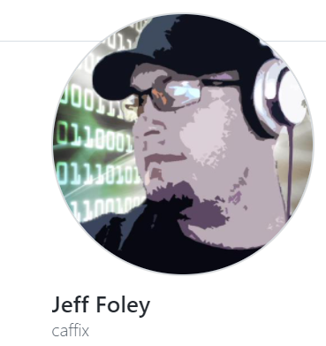

AMASS - https://github.com/OWASP/Amass
Developed by Jeff Foley (@jeff_foley) and OWASP to help organizations discover their attack surface. Focused on asset discovery, DNS enumeration, and attack surface mapping.

Slide 13
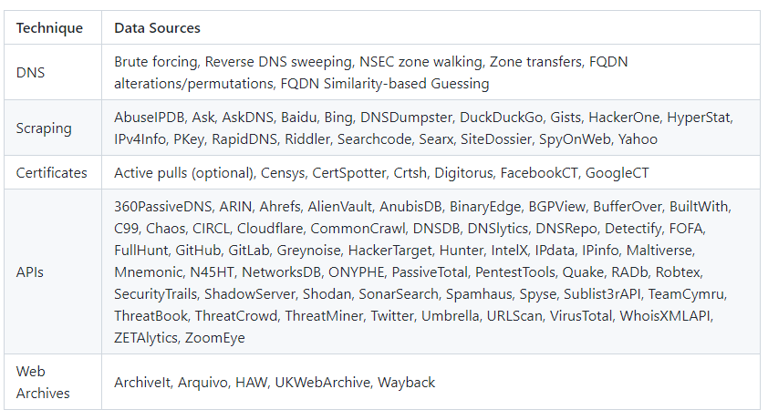
Data Sources Used and API Integrations

Slide 14
Installing AMASS
Windows
Download and install the binary.
https://github.com/OWASP/Amass/releases/download/v3.16.0/amass_windows_amd64.zip
Kali Linux or Ubuntu
sudo apt install amass
Mac OSX using Homebrew
brew tap caffix/amass
brew install amass
Docker
docker pull caffix/amass

Slide 15
AMASS Commands
intel
Gathers open source intelligence.
WHOIS Data
Example
amass intel -whois -d [target_domain]
enum
Enumerates DNS and network maps systems that are exposed to the internet.
Example
amass enum -d [target_domain]
viz
Create network graph visualizations
HTML, Maltego, Graphistry
Example
amass viz -d3 -d [target_domain]
db
Manages the databases storing enumeration information.
Example
amass db -show -ip -d [target_domain]
track
Compares the results of multiple targets.
Good for global organizations and multiple domains.
amass track -df [target_domains].txt

Slide 16
AMASS Intel (using docker)
Gather WHOIS data against the target
Windows + Docker
docker run -rm caffix/amass intel -whois -d example.com
Using the binary (Windows, Linux, Mac)
amass intel -whois -d example.com

Slide 17
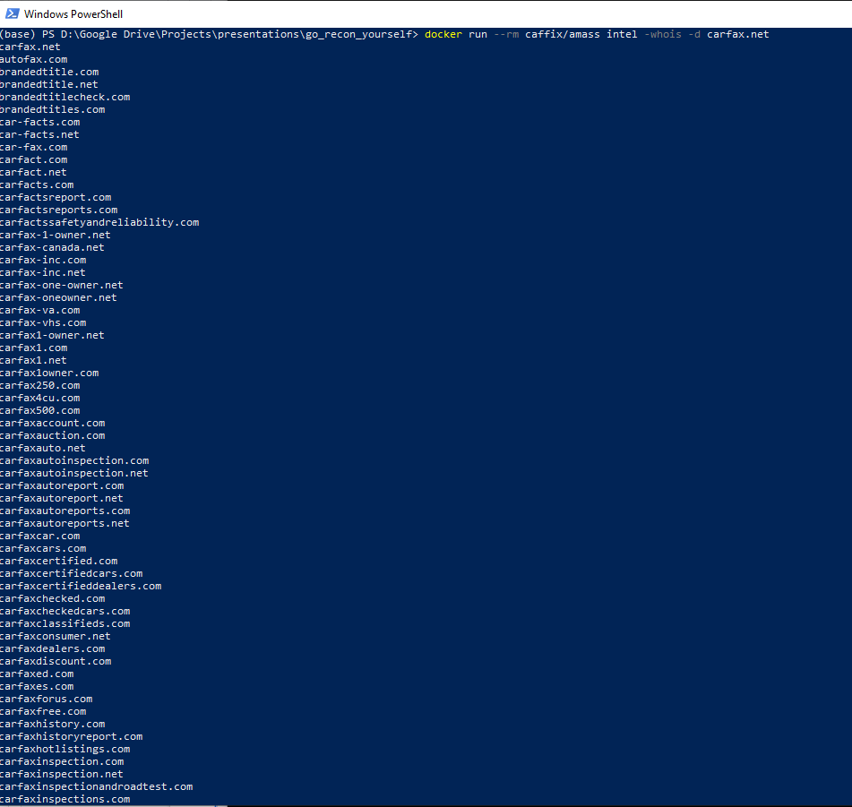
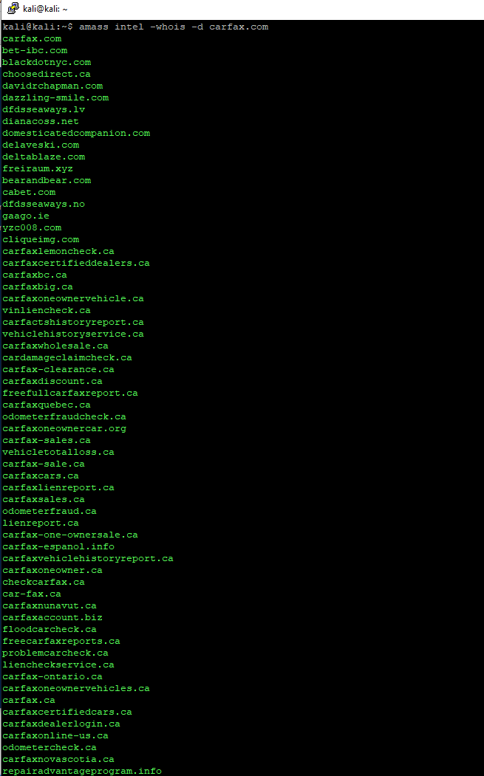

Slide 18
2. AMASS Enumeration (using docker)
Enumerate the public Network data
docker run -rm caffix/amass enum -d example.com
amass enum -d example.com

Slide 19
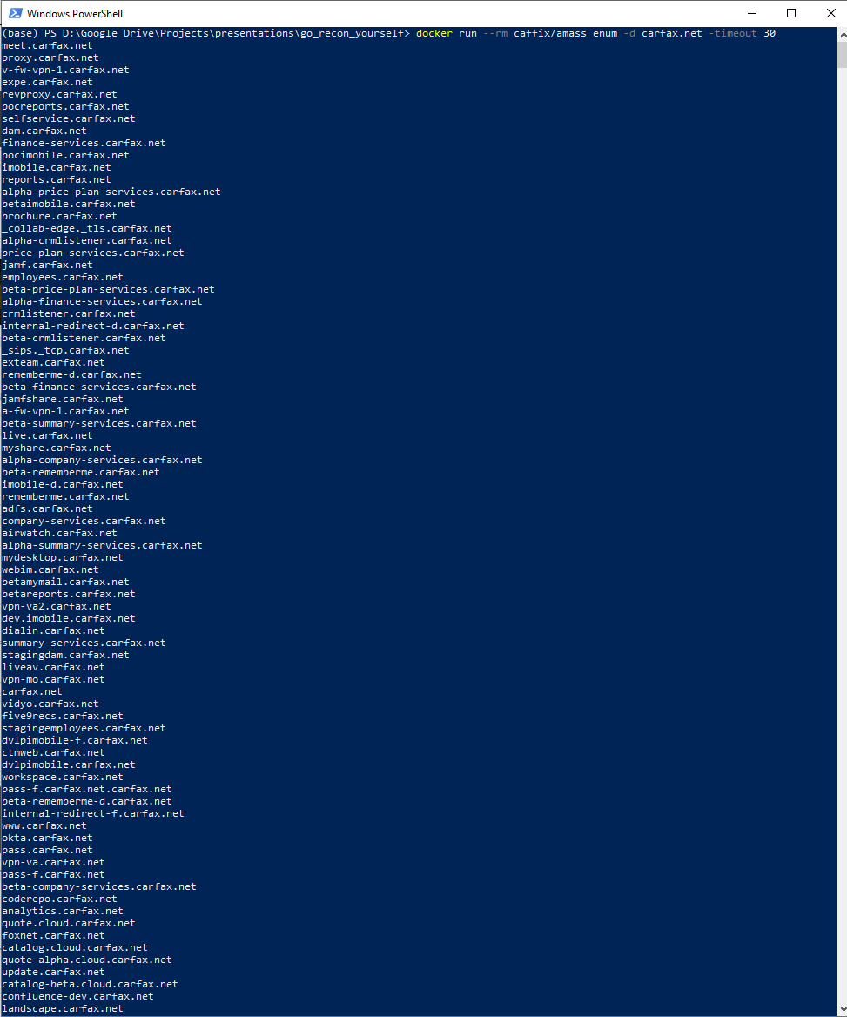
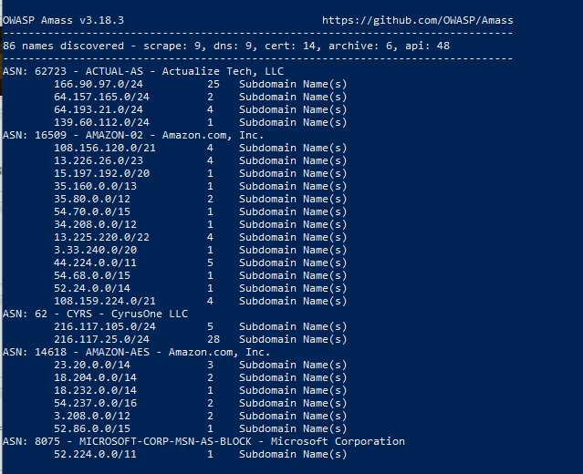

Slide 20
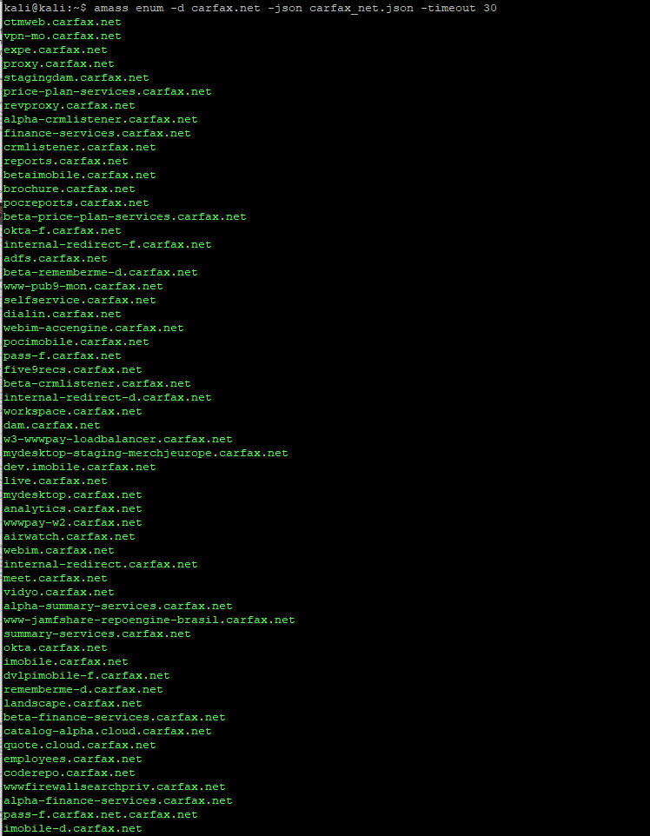
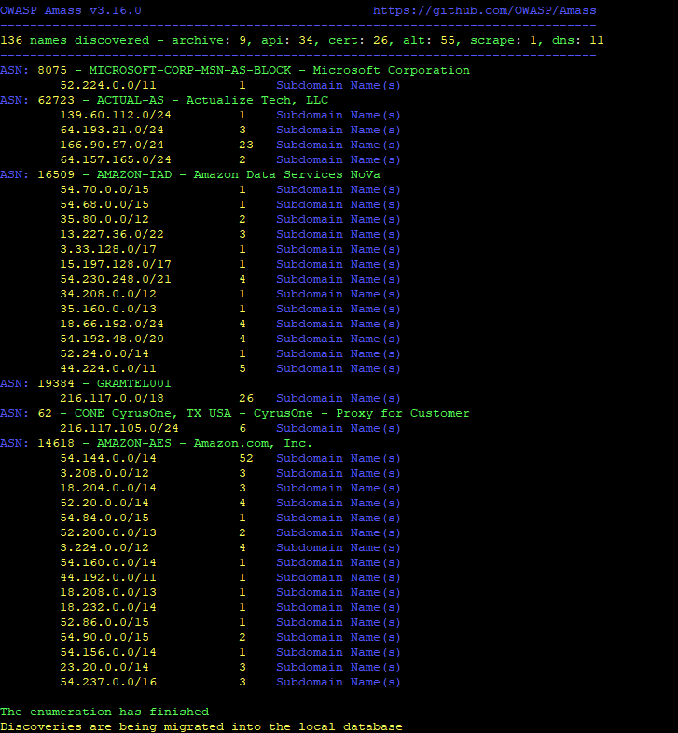

Slide 21
2. AMASS Database (using docker)
Enumerate the public Network data
docker run -rm caffix/amass db -show -ip -d example.com
amass db -show -ip -d example.com

Slide 22
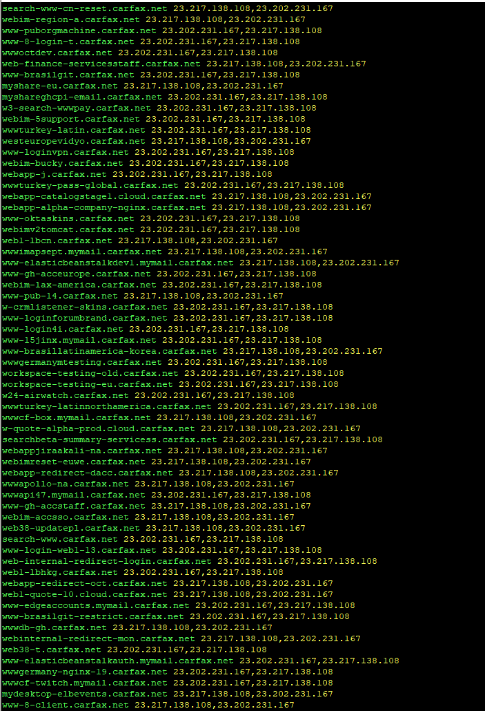

Slide 23
My favorite flags
intel
-o
Outputs to a text file
Example
docker run –rm caffix/amass intel -whois -d example.com -o example_WHOIS_com.txt
amass intel -whois -d [target_domain] -o example_WHOIS_com.txt
enum
-json [file.json] -o [file.txt]
Saves to json file.
Example
docker run –rm caffix/amass enum -d example.com -json example_enum_com.json -o example_enum_com.txt
amass enum -d example.com -json example_enum_com.json -o example_enum_com.txt

Slide 24
AMASS’ing yourself quickly (save this info):
Using Docker
Run AMASS Intel command to gather the information and save to a text file.
docker run -rm caffix/amass intel -whois -d example.com -o results.txt
Run AMASS Enum, enumerate the domain, and save the information.
docker run -rm caffix/amass enum -d example.com -json example_enum_com.json -o enum_example_com.txt

Slide 25
Limitations
Accuracy of data
Sometimes the data is not completely accurate.
What is live vs what is decommissioned?
Slow
Data is scraped from a large amount of resources and consolidated into one place.
Need to add -timeout flag to every command invoked.
docker run –rm caffix/amass enum -d example.com -json example_com.json -timeout 30 Minutes
No GUI
Easy to learn, but if someone is used to a GUI there is a bit of a learning curve.
Risk Scoring
How do you risk score assets that may have compensating controls?

Slide 26
Perimeter Scanning

Slide 27
Recon Profile Check
Text file of WHOIS Intel domains in example_whois_com.txt
Enumerated services in our example_com.json file AND example_enum_com.txt

Slide 28

Paradigm
Open source tool that analyzes discovered assets and reports if they are available to the public internet.
Web UI that analyzes the enumeration JSON files you save from AMASS.
Small risk scoring system that tells you what percentage of your discovered environment is open to the internet.
https://github.com/jeredbare/paradigm

Slide 29
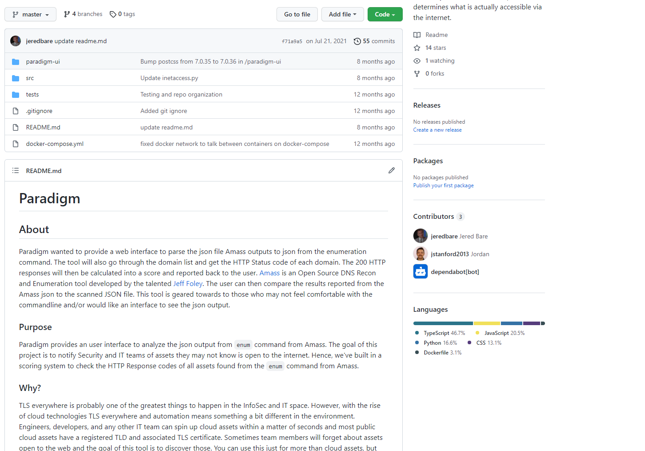

Slide 30
Paradigm Yourself
Download and install Docker + docker-compose
https://docs.docker.com/get-docker/
Download the repository
https://github.com/jeredbare/paradigm
Build the container
Unzip the repository.
Go into that directory and run docker-compose build
Running the container and navigate to the web interface
docker-compose up
Go to http://localhost:3000 in a web browser

Slide 31
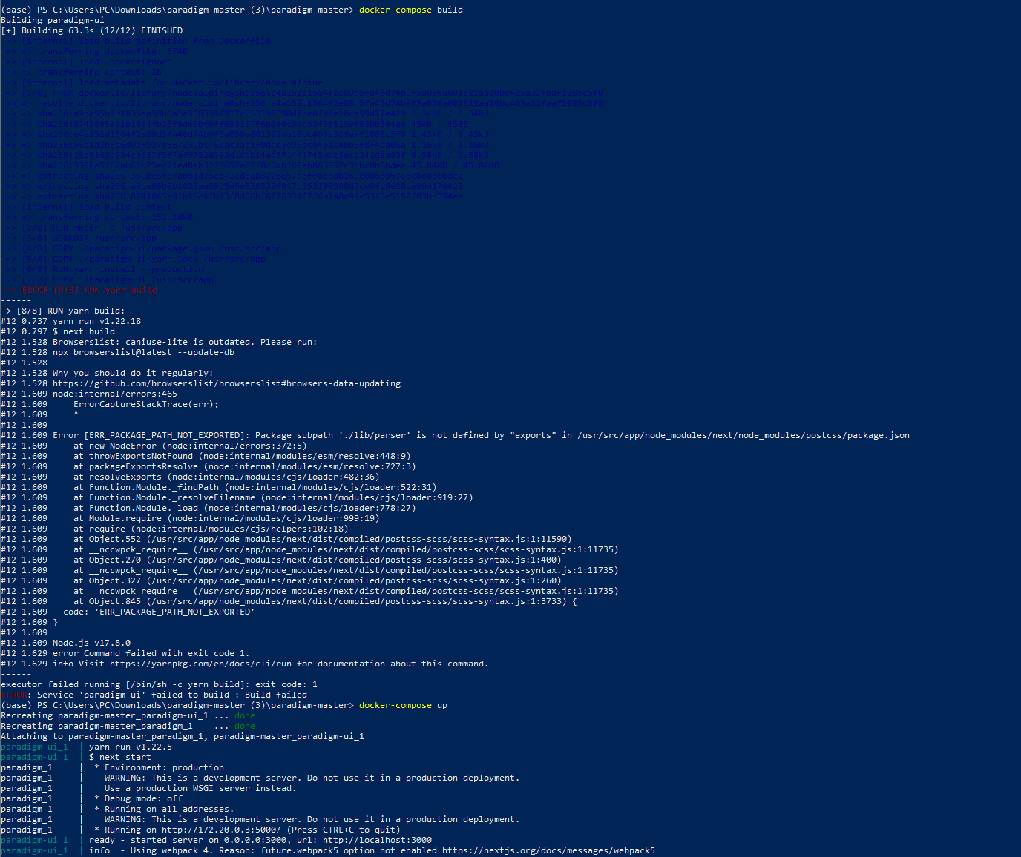

Slide 32
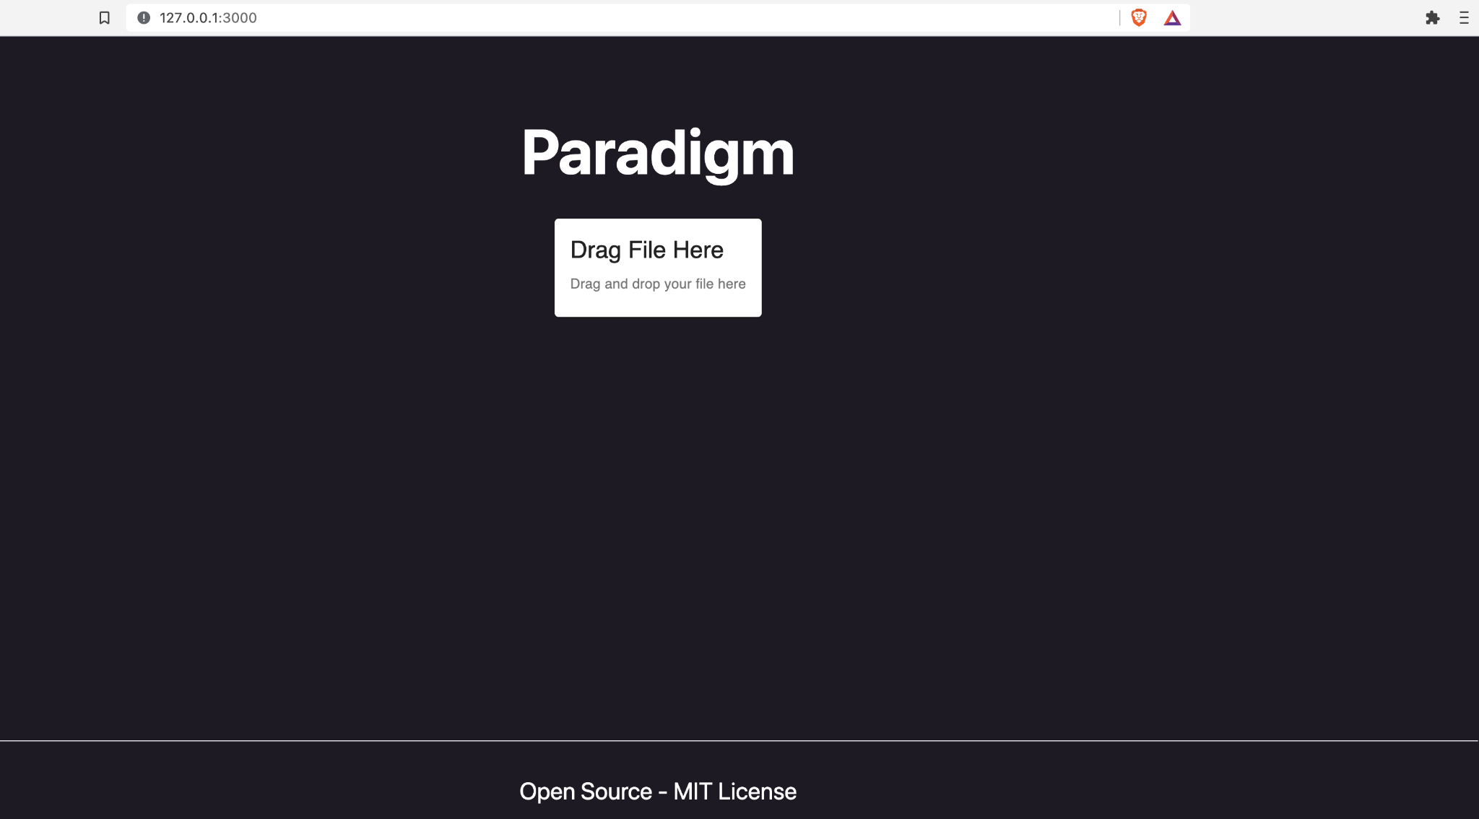

Slide 33
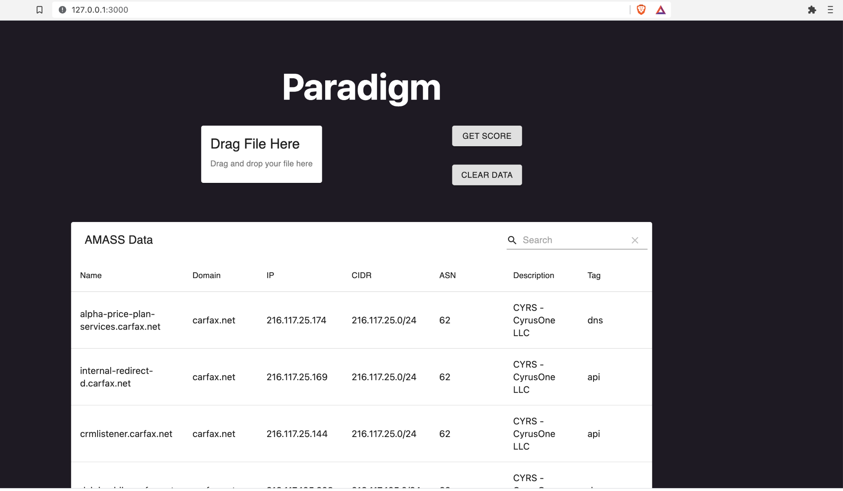

Slide 34
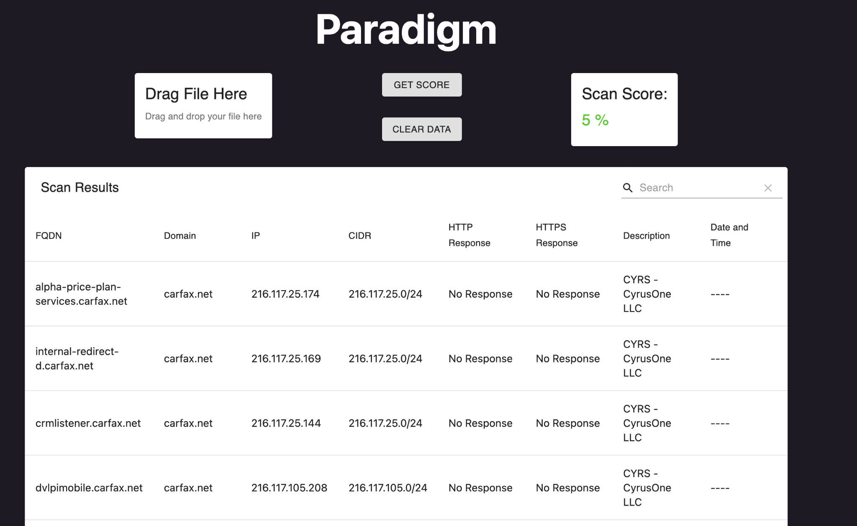

Slide 35
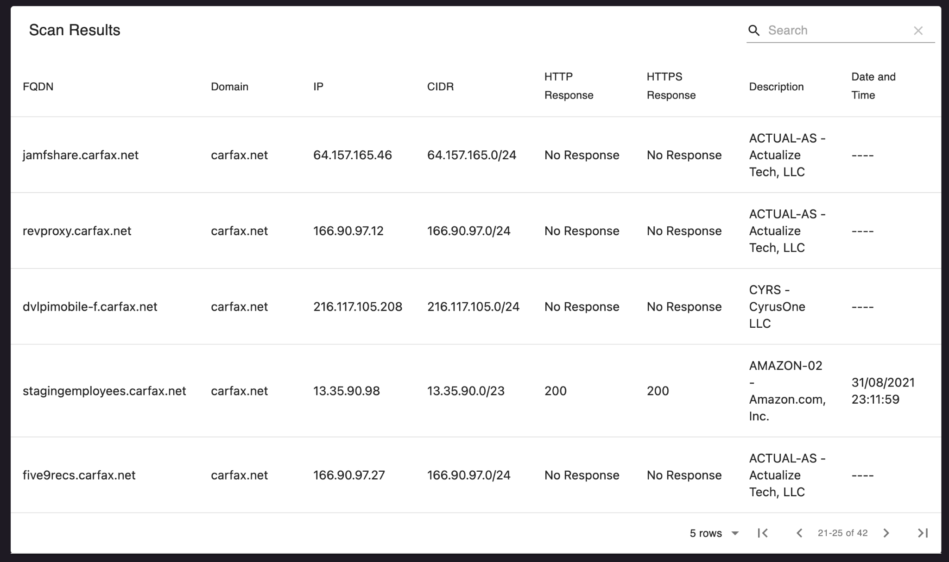

Slide 36
Paradigm Limitations
Buggy
Application will crash with a properly formatted JSON file.
Have to upload files saved from amass enum -d [target_domain] -json [target_domain].json
Risk Score does not account for compensating controls
Every domain available to the internet is not a risk.

Slide 37

NMAP
NMAP is a network port scanner that is compatible with all operating systems.
Windows
Mac OSX
Linux
Docker
Used by Security Pros, Network Engineers, IT Pros.
Has a robust scripting engine (LUA)
Checking for certificate ciphers.
Brute forcing engine.
Basic network vulnerability scanning.

Slide 38
NMAP Commands – Scanning Yourself
Scanning a Single IP
nmap -sV -A -T4 192.168.1.2
Scanning a CIDR Block
nmap -sV -A -T4 192.168.1.0/24
Scanning a FQDN
nmap -sV -A -T4 scanme.nmap.org

Slide 39
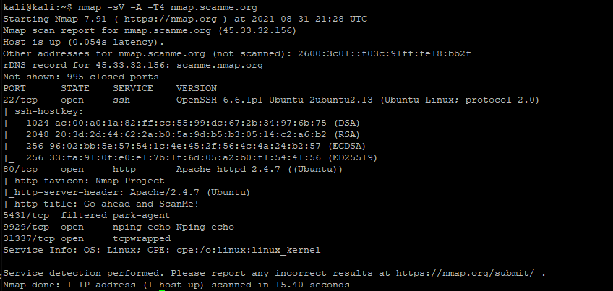

Slide 40
NMAP Commands – Scanning The Perimeter
Scanning a Single IP
nmap -sV -A -T4 192.168.1.2
Scanning a CIDR Block
nmap -sV -A -T4 192.168.1.0/24
Scanning a FQDN
nmap -sV -A -T4 scanme.nmap.org
Scan a list of targets (importing our Recon evidence)
nmap -sV -A -T4 -iL example_enum_com.txt

Slide 41
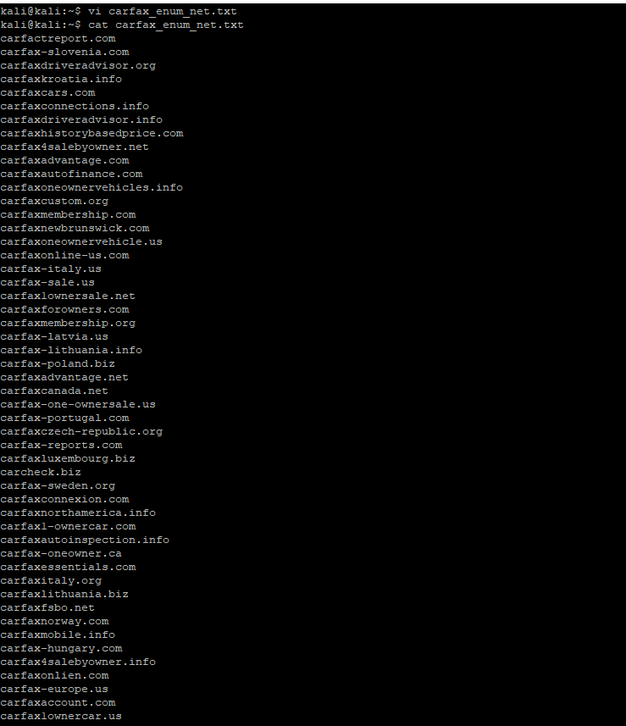
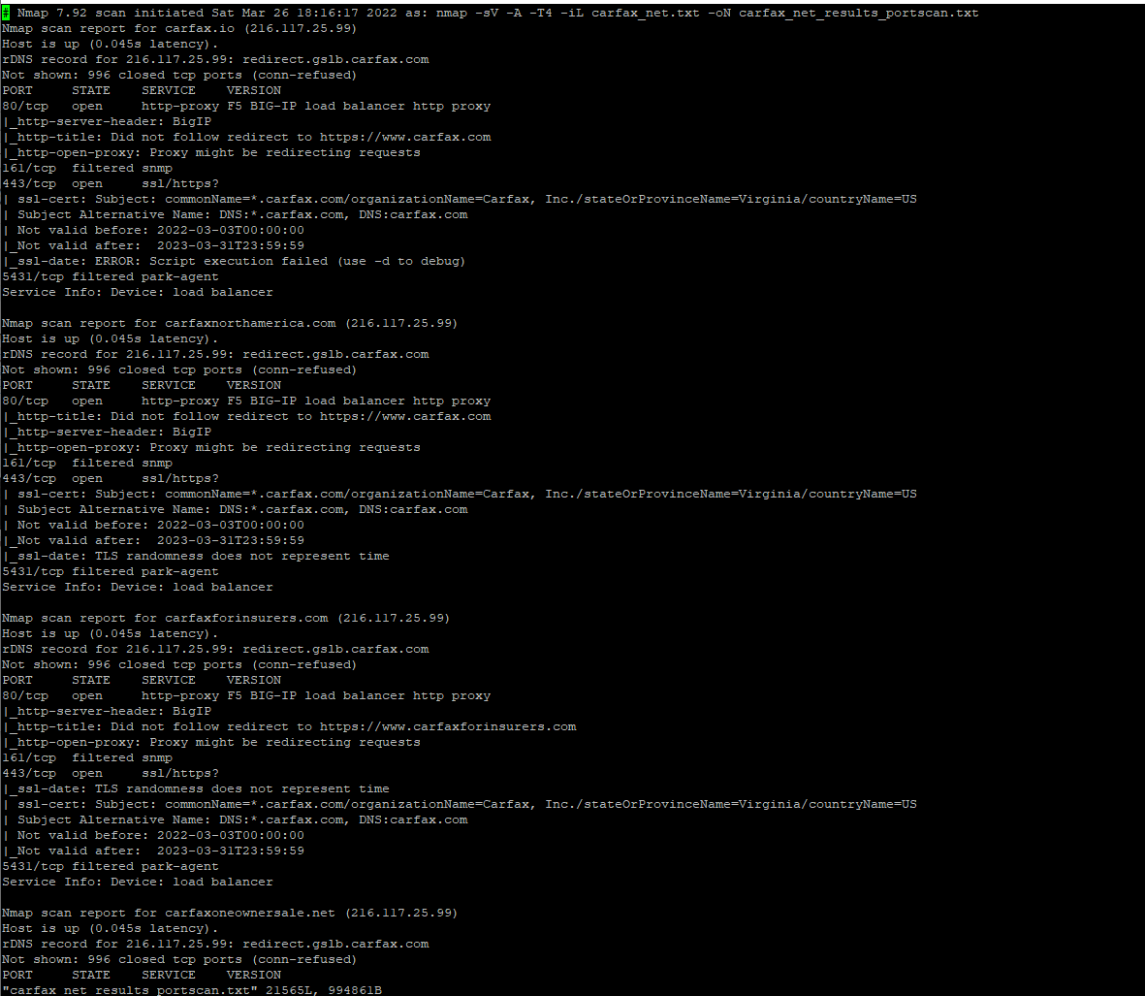

Slide 42
NMAP Commands – Adding to our Recon Profile
Scanning a Single IP
nmap -sV -A -T4 192.168.1.2
Scanning a CIDR Block
nmap -sV -A -T4 192.168.1.0/24
Scanning a FQDN
nmap -sV -A -T4 scanme.nmap.org
Scan a list of targets (importing our Recon evidence)
nmap -sV -A -T4 -iL example_com.txt
Saving the port scan results
nmap -sV -A -T4 -iL example_com.txt -oN example_com_results.txt

Slide 43
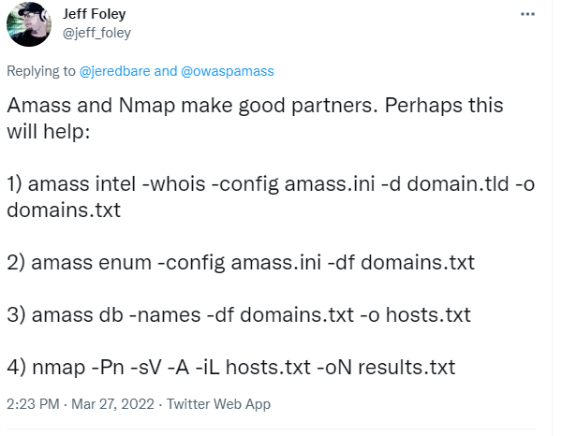
NMAP Commands – Adding to our Recon Profile

Slide 44
NMAP Limitations
Sometimes can be slow.
Noisy -- most IPS/IDS can pick up the port scanning activity.
You can manipulate packets to evade some IPS/IDS.
Well known by attackers and defenders.
Will sometimes break itself or other things.

Slide 45
Recon Profile Check
Text file of WHOIS Intel domains in example_whois_com.txt
Enumerated services in our example_com.json file AND example_enum_com.txt
We know which domains respond to GET requests (200 Code)
Ports scanned by NMAP and saved in example_com_results.txt

Slide 46

Nikto – Scanning the Perimeter (Web Apps)
Open source web vulnerability scanner.
Built into Kali Linux, but can be used with Docker and other Linux flavors.
Really good for quick scans to determine baseline vulnerabilities.
https://cirt.net/Nikto2
Running nikto (in Kali Linux)
nikto -host [domain_or_ip]:[port]-o example_com_webapps.txt

Slide 47
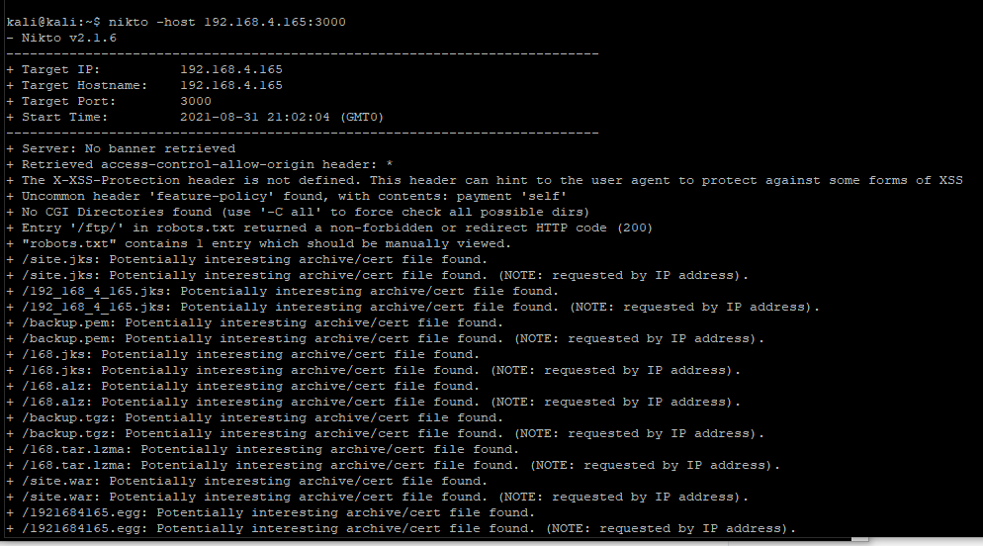

Slide 48
Nikto – Limitations
Has a finite amount of signatures.
VERY NOISY: Any basic IDS/IPS will pick up these activities.
Does not replace commercial web vulnerability scanners, good for recon profiling.

Slide 49
Cloud Scanning

Slide 50

GrayHat Warfare - Cloud Recon
Online search for open AWS S3 Buckets, GCP Instances, and Azure blobs.
You can find misconfigured cloud assets in this search engine.
You can also find
Passwords
User accounts
Credit Card numbers
And….some other interesting stuff

Slide 51
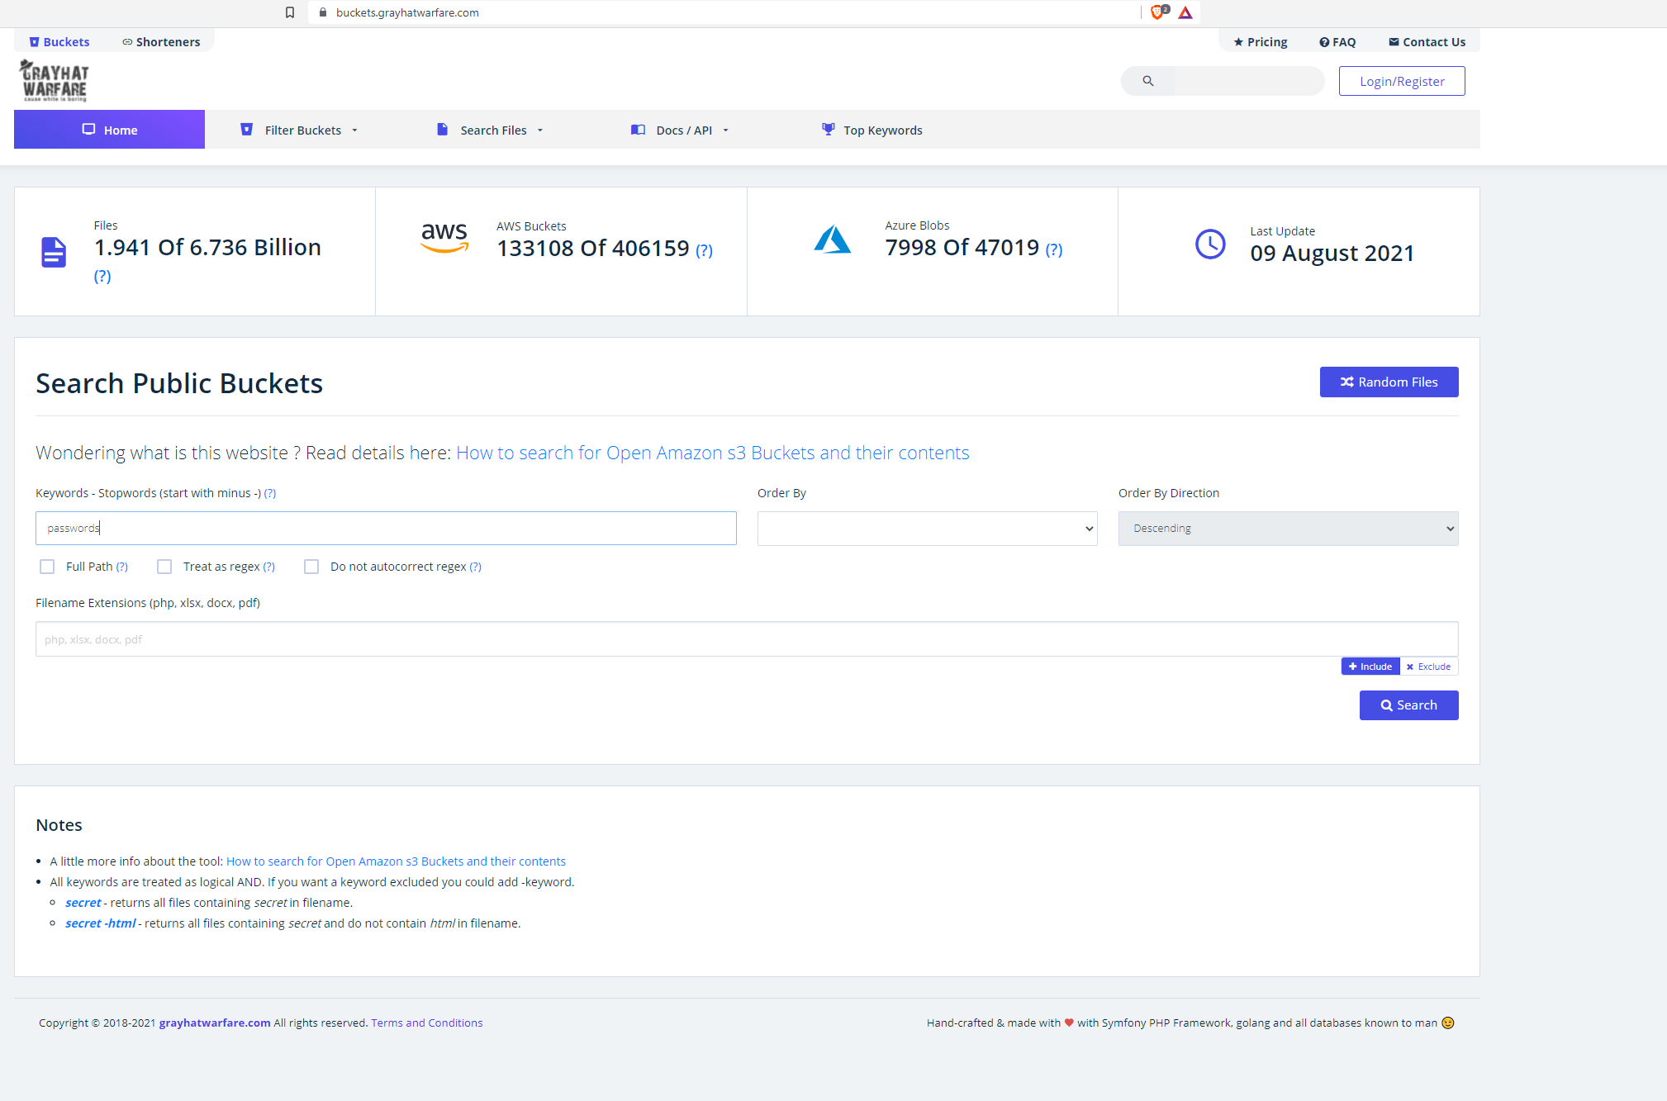

Slide 52
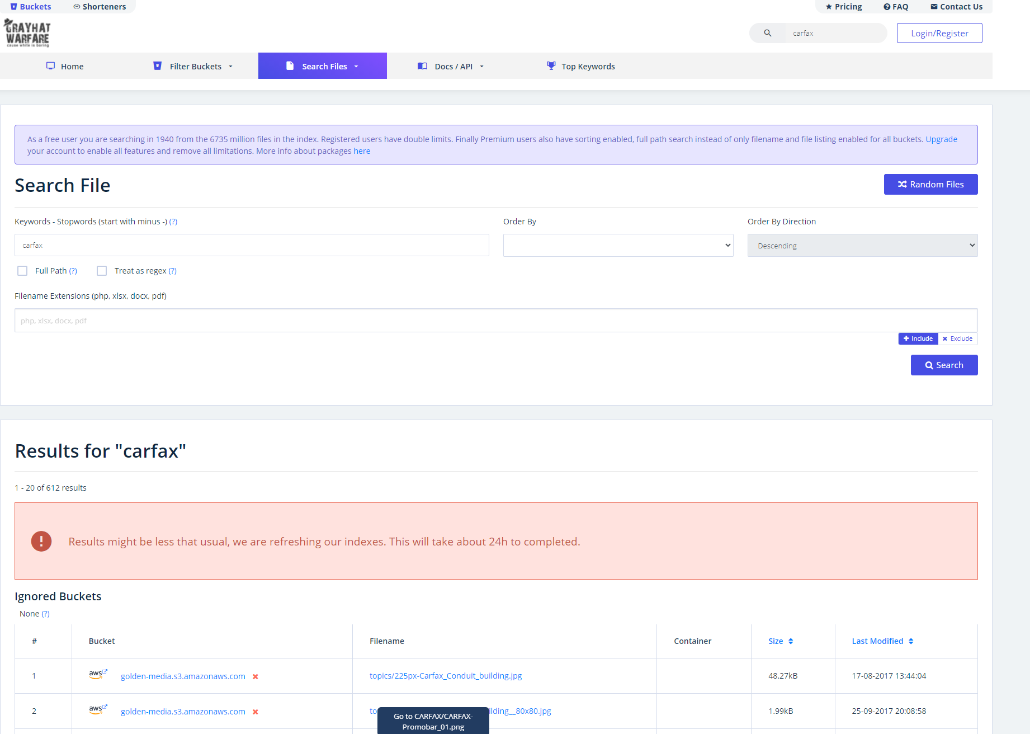

Slide 53
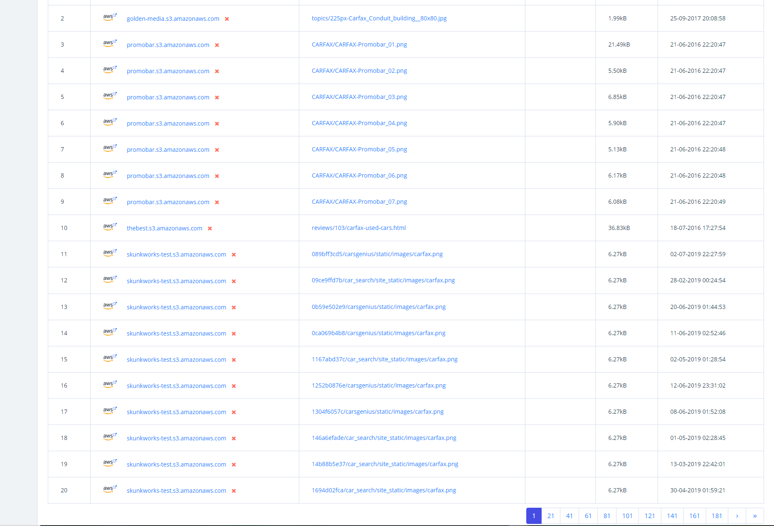

Slide 54
GrayHat Warfare - Limitations
Cost some money.
Only looks for certain misconfigured items and ignores different tech stacks.
Serverless
Lamda
Limited query searches

Slide 55
Recon Profile Check
Text file of WHOIS Intel domains in example_whois_com.txt
Enumerated services in our example_com.json file AND example_enum_com.txt
Ports scanned by NMAP and saved in example_com_results.json
Scanned our web applications for vulnerabilities (if any).
Determined our cloud assets that may be misconfigured.

Slide 56
Monitoring

Slide 57

Shodan – Monitoring your External Assets
A search engine that scans the entire internet for internet connected devices.
Gained notoriety for IP Cameras connected to the internet.
Port scans and sweeps the entire internet:
Scans all known and unknown ports.
Banner grabs from these ports.
Also determines what vulnerabilities may exist on the host.

Slide 58
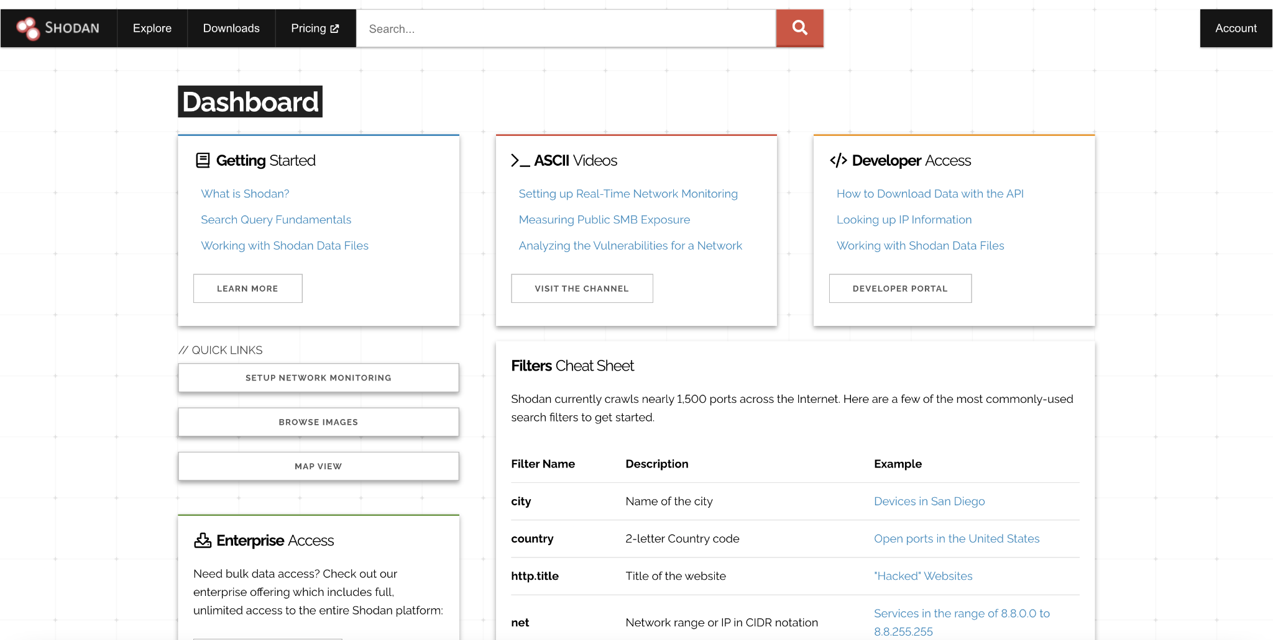

Slide 59
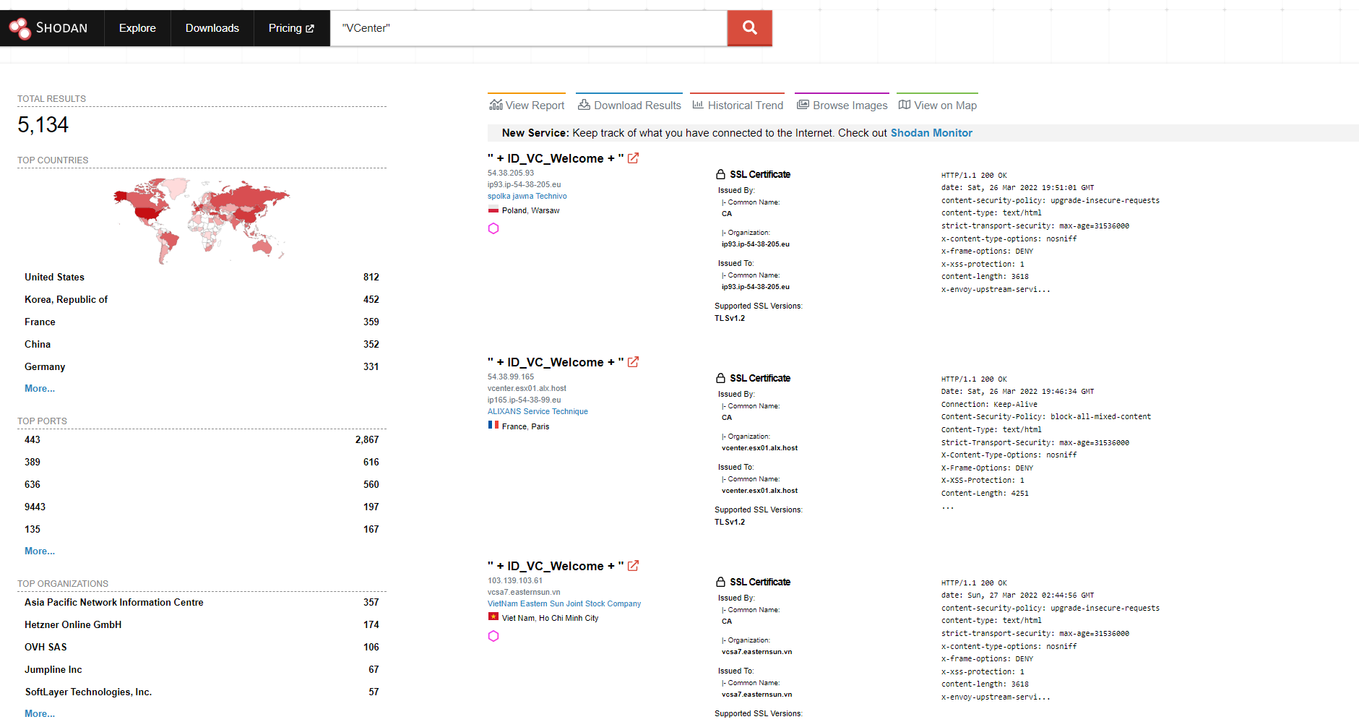

Slide 60
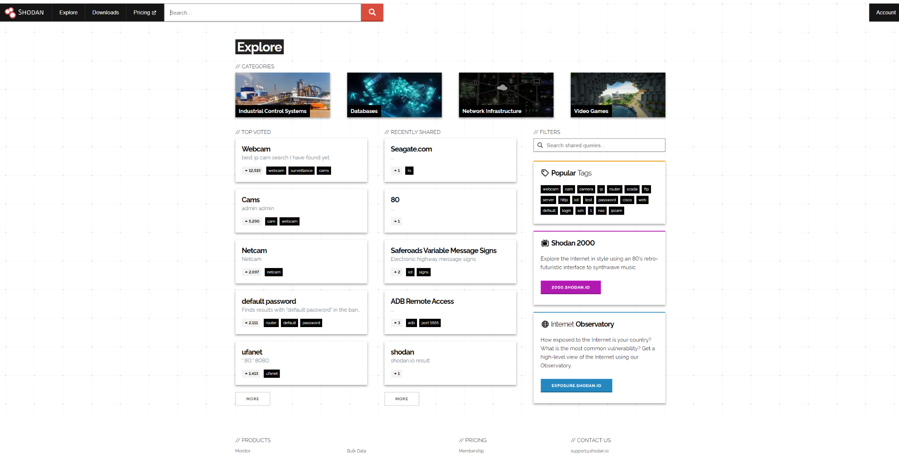

Slide 61
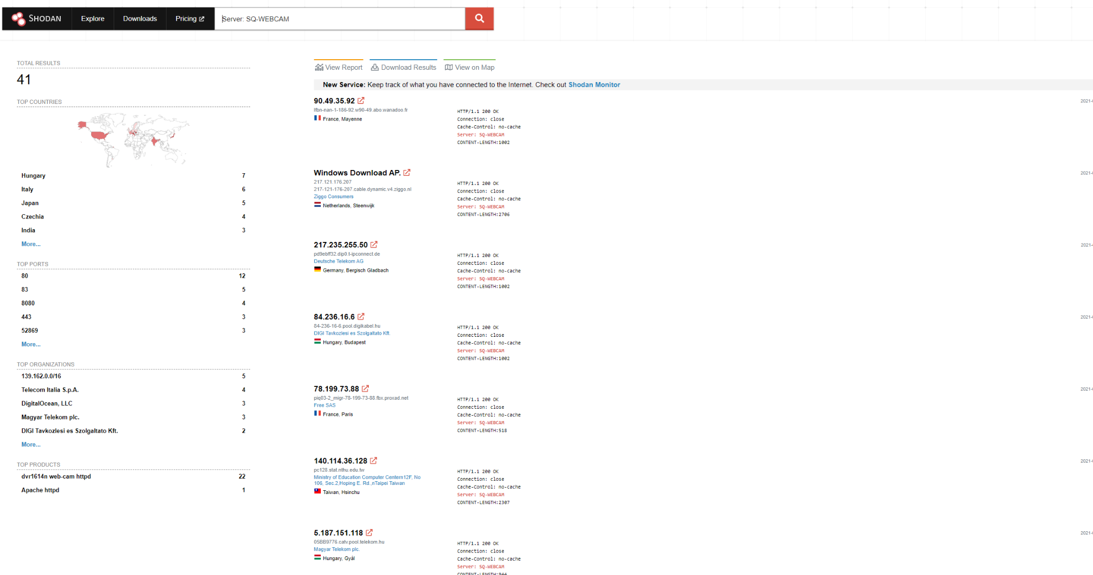

Slide 62
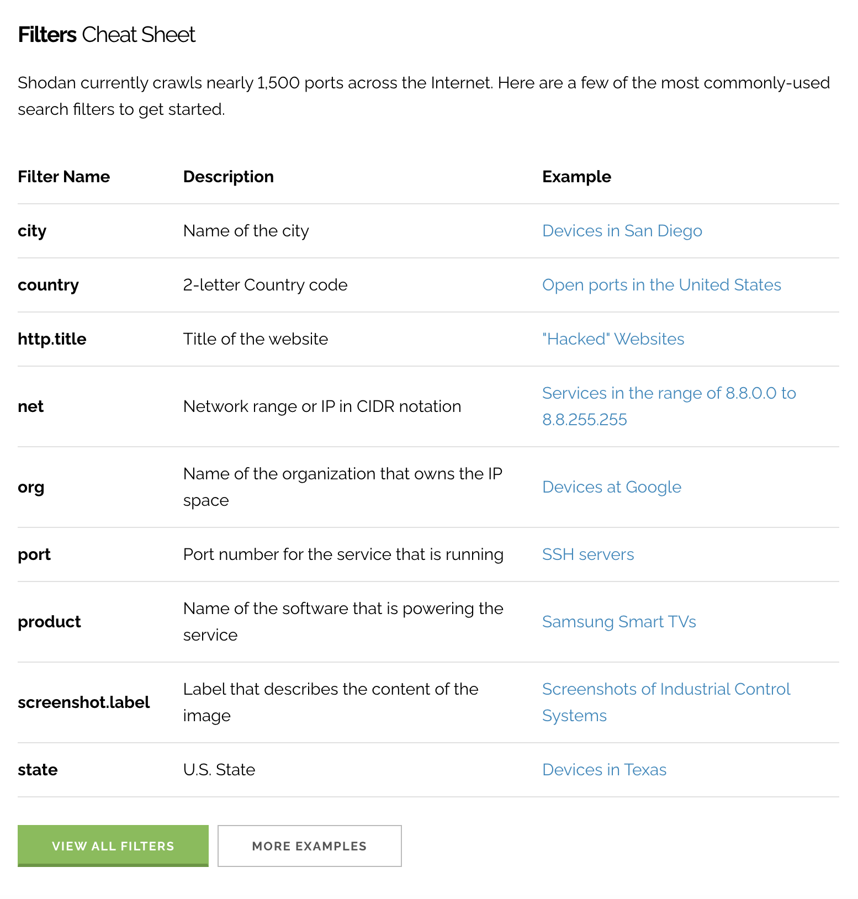
Filters and Examples:
city:Springfield -- Must be a [string]
country: US -- Must be a [string]
http.title:”Hacked by” -- Can be [string] or [float]
net:198.209.10.0/27 -- Has to be a [float]
org:CenturyLink -- Has to be a [string]
port:445 -- Has to be an [int]
product:Exchange -- Can be a [string] and/or [float]
screenshot.label:ics -- Can be a [string] and/or [float]
state:”MO”

Slide 63
Shodan – Let’s apply it locally – Apologies ahead of time
Let’s find all the servers that have SMB1 enabled.
Filters we’re using
state, city, port
Our query
state:MO city:Springfield port:445

Slide 64
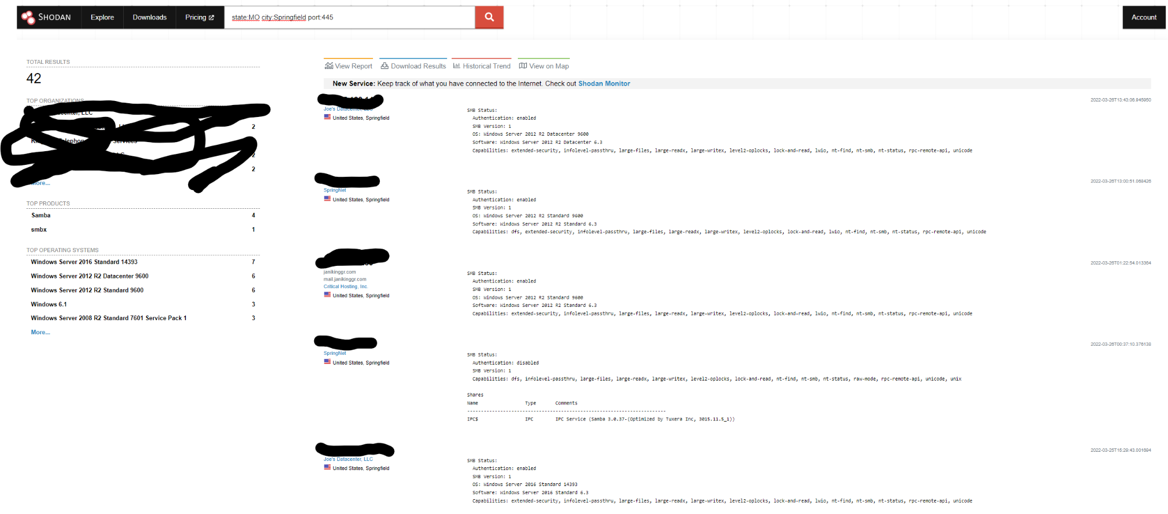

Slide 65
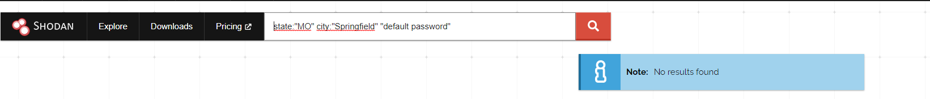
Shodan – Let’s apply it locally – Apologies ahead of time
Let’s find all the servers that have a default password locally
Filters we’re using
state, city, [string]
Our query
state:”MO” city:”Springfield” “default password”

Slide 66
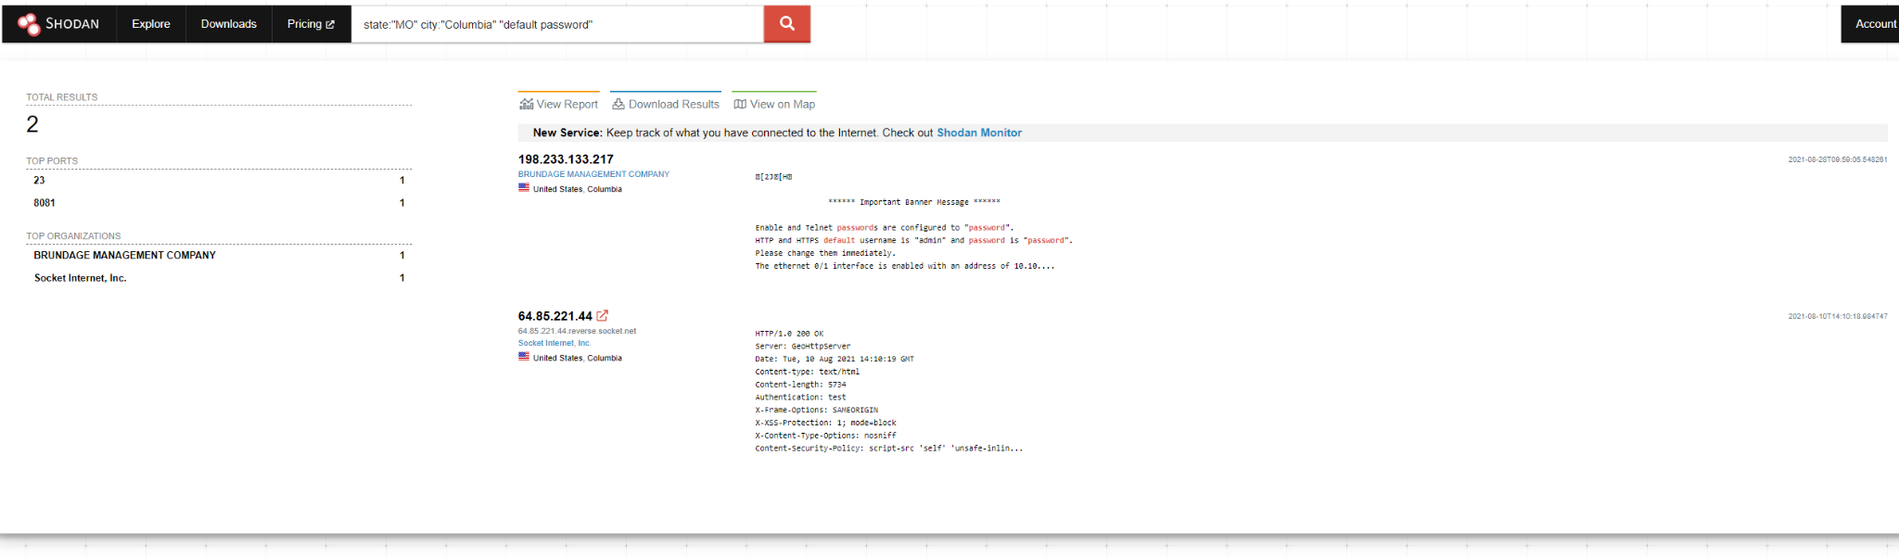
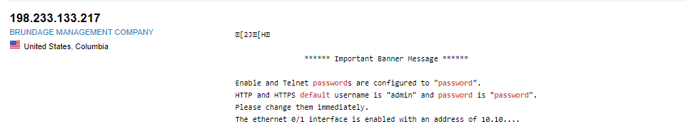
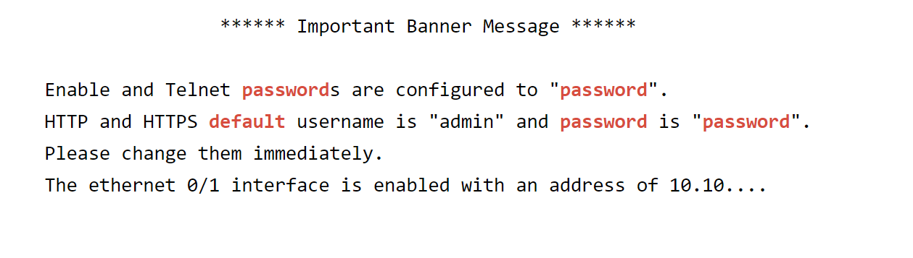


Slide 67
Shodan – Let’s apply it locally – Apologies ahead of time
Let’s find all the servers that have potentially been hacked in the state of Missouri.
Filters we’re using
state, http.title
Our query
state:”MO” http.title:“hacked by”

Slide 68
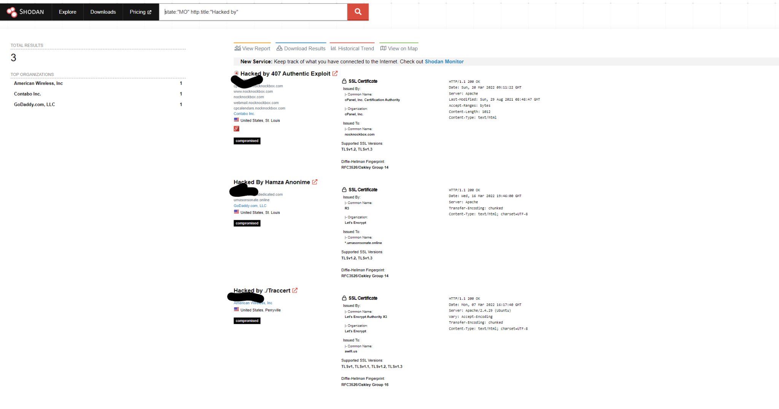

Slide 69
Shodan – Let’s apply it locally – Apologies ahead of time
Let’s find all the ICS systems in the state of Missouri.
Filters we’re using
state, screenshot.label
Our query
state:”MO” screenshot.label:ics

Slide 70
Disclaimer x 2:
Please be careful with this information. Remember, I nor the conference organizers are responsible for what you do with this presentation. Be good. Do good. If not…

Slide 71


Slide 72
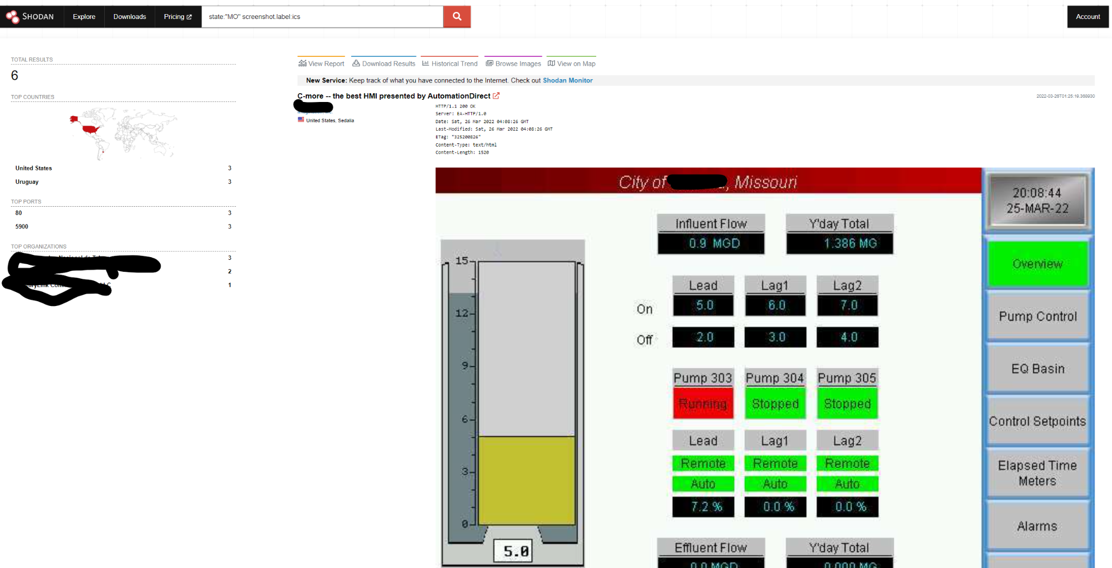

Slide 73
Recon Profile Check
Text file of WHOIS Intel domains in example_whois_com.txt
Enumerated services in our example_com.json file AND example_enum_com.txt
Ports scanned by NMAP and saved in example_com_results.json
Scanned our web applications for vulnerabilities (if any).
Determined our cloud assets that may be misconfigured.

Slide 74
Shodan – Let’s apply it to us!
Let’s use the net and ip filters to find if our assets have been scanned
Filter we’re using
net
Our query
net: [ip or cidr]

Slide 75
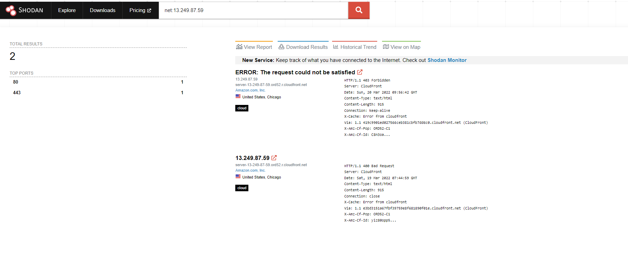

Slide 76
Shodan – Let’s apply it to us!
Let’s use the net and ip filters to find if our assets have been scanned
Filter we’re using
net
Our query
net: [ip or cidr]

Slide 77
Recon Profile Check

Slide 78
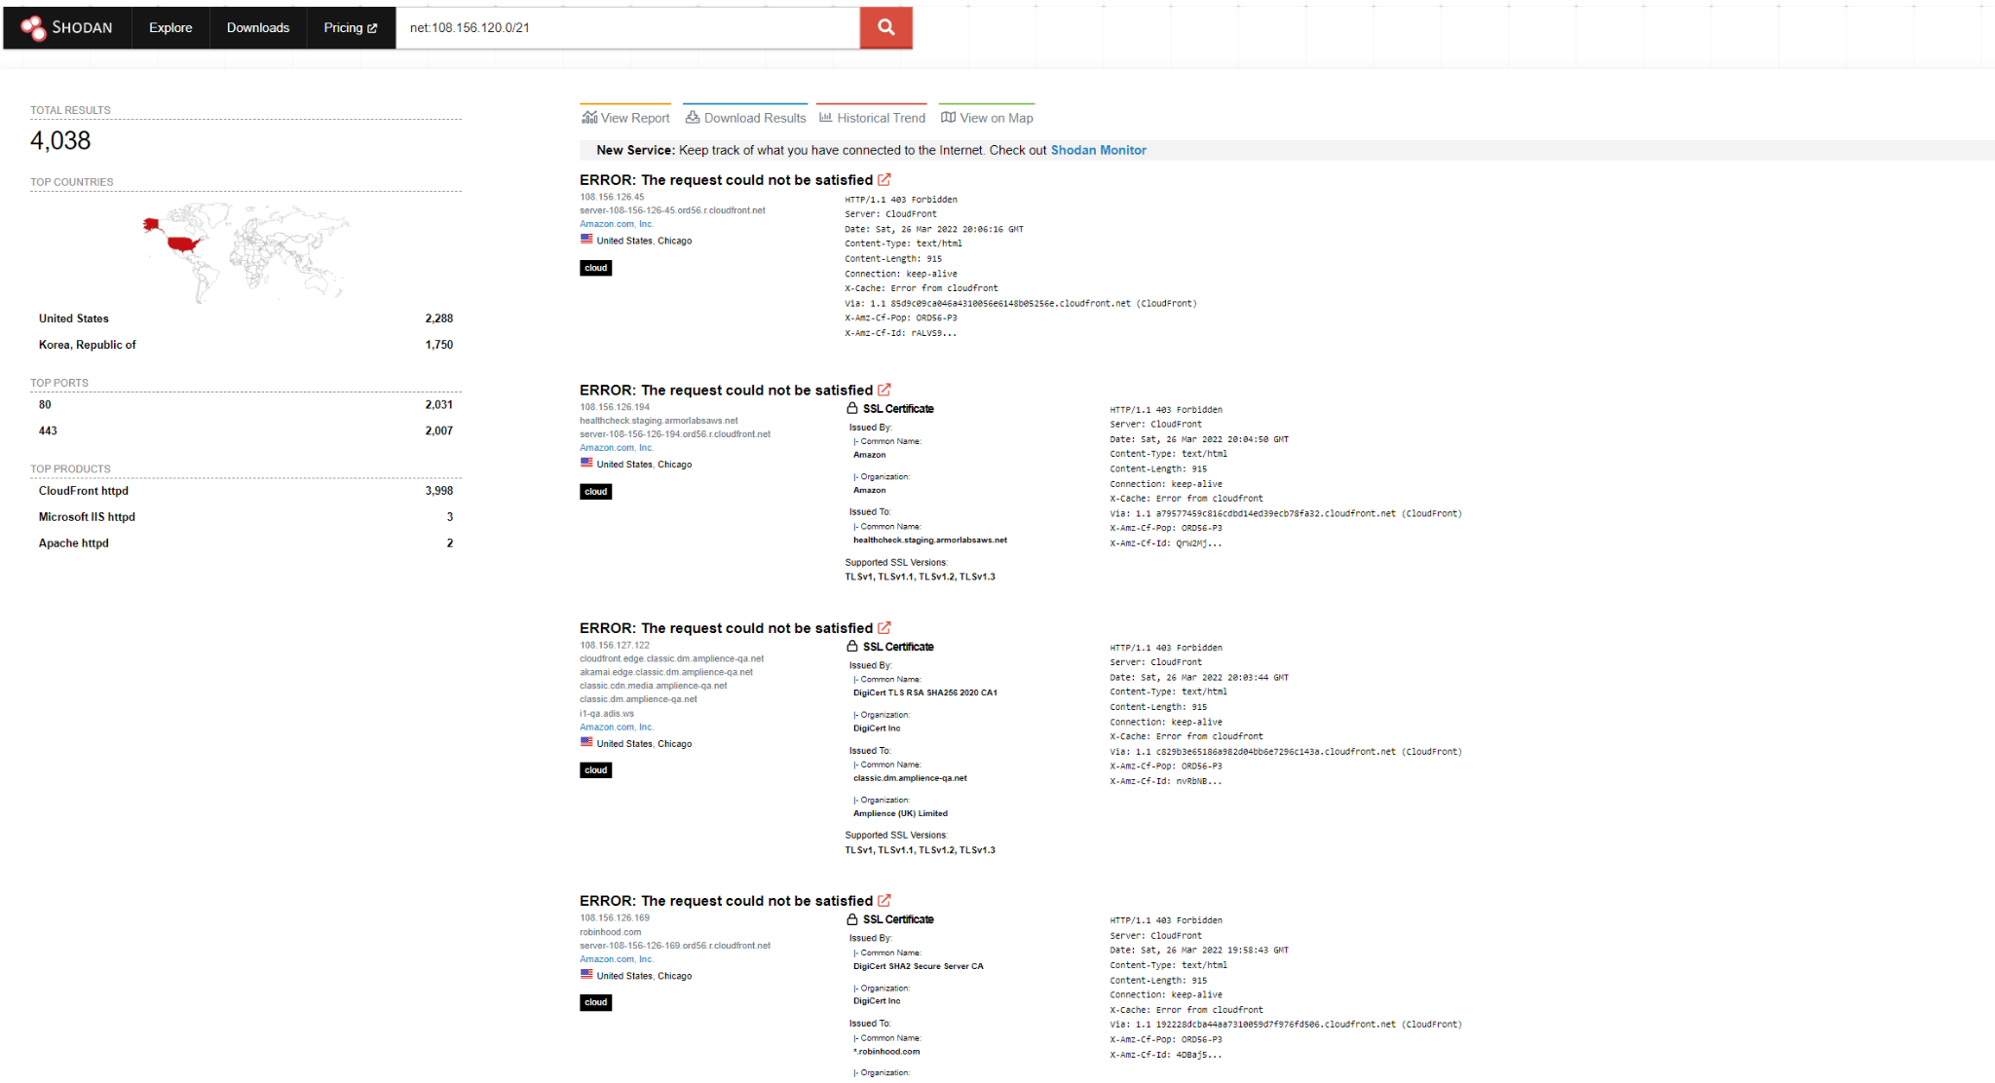

Slide 79
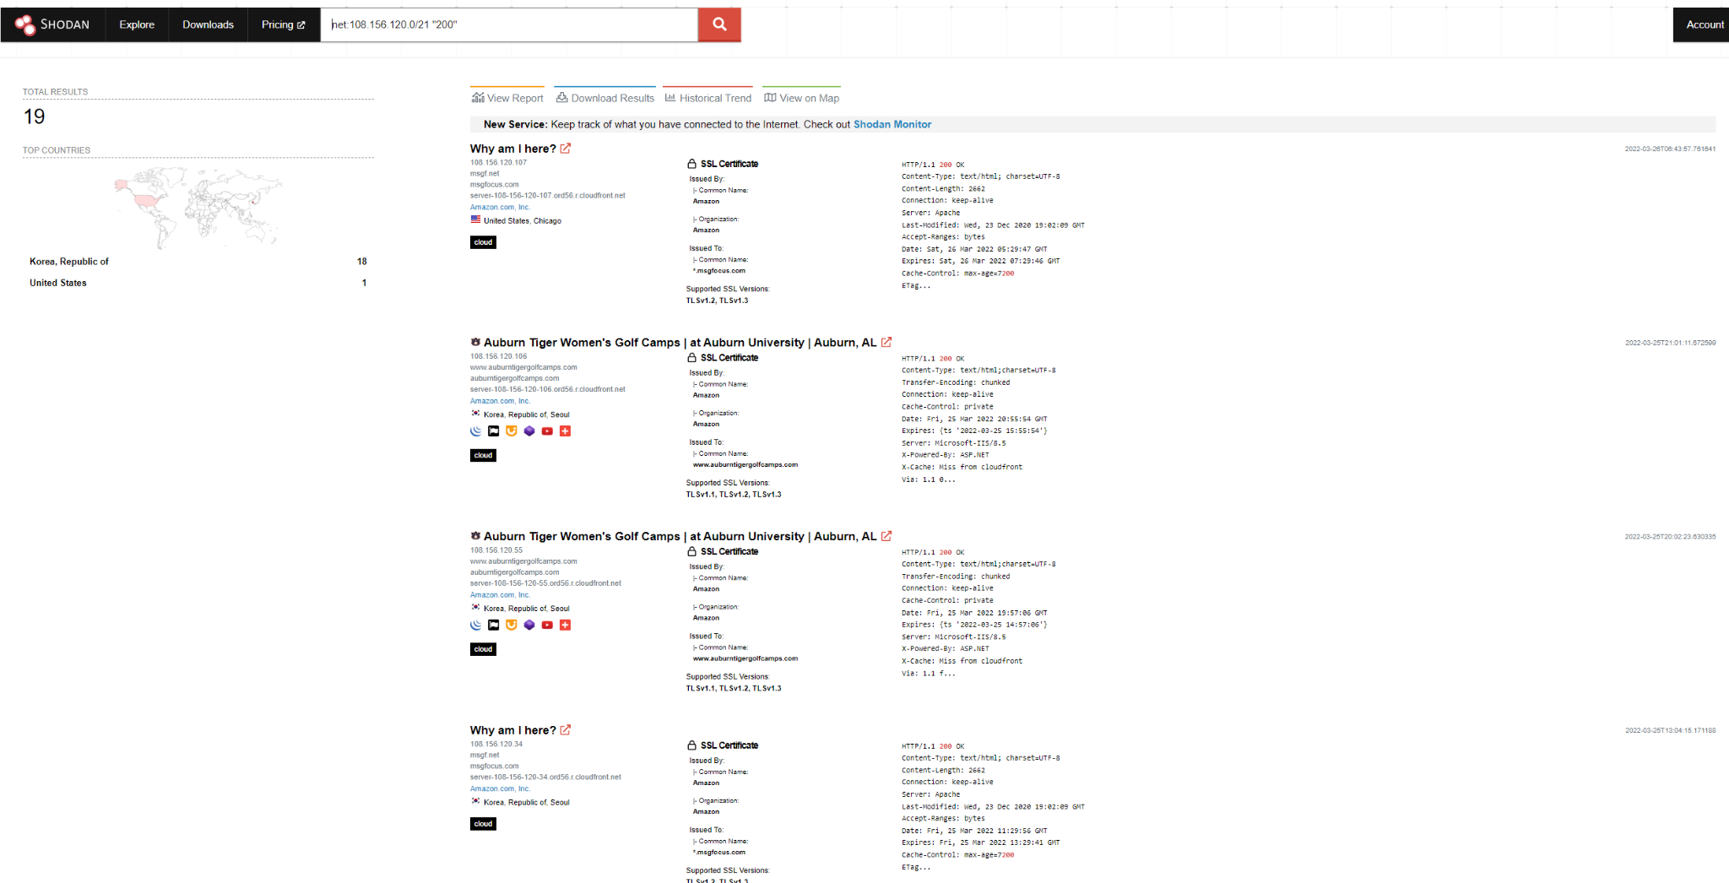

Slide 80
The darker side of Shodan
Disclaimer x 3:
What I’m about to show you is the exact reason why we need to get recon and infosec right. Your organization could possibly be here someday. Again: Be good. Do good.

Slide 81
X 2

Slide 82
[REDACTED]

Slide 83
[REDACTED]

Slide 84
[REDACTED]

Slide 85
Shodan Limitations
Scans are old
About 1 - 2 weeks old.
Little Expensive
Need to catch the $50 sale.
Real time monitoring cost $$$
False positives
Due to the age of the scans, there can be false positives.
Honeypots
Shodan cannot tell whether something is a honey pot or not.
Doesn’t really give you the whole “picture”.
Compensating controls; Firewalls, WAFs, IDS/IPS

Slide 86
Determining Risk

Slide 87
Risk…is complicated and subjective
Just because something is connected to the internet doesn’t mean it’s inherently risky.

Slide 88
Risk Analysis with Reconnaissance
http://www.example.com
https://employeereports.example.com
https://creditcards.example.com
Ports Open 80
Web Vulnerabilities Open Redirect
Manual Validation Front end and Static website. No calls to backend APIs. No WAF. Hosting AWS
Ports Open 443
Web Vulnerabilities Medium Reflected XSS
Manual Validation Site that has a full stack framework: front, back, DB. Calls to backend APIs. Outdated WAF Hosting AWS
Ports Open 443, 80 (301)
Web Vulnerabilities None
Manual Validation Site that has a full stack framework: front, back, DB. Calls to backend Auth APIs. WAF, DMZ, Up to date code. Hosting On Prem

Slide 89
2. Risk Analysis with Reconnaissance
http://www.example.com
https://employeereports.example.com
https://creditcards.example.com
Ports Open 80
Web Vulnerabilities Open Redirect
Manual Validation Front end and Static website. No calls to backend APIs. No WAF. Hosting AWS
Ports Open 443
Web Vulnerabilities Medium Reflected XSS
Manual Validation Site that has a full stack framework: front, back, DB. Calls to backend APIs. Outdated WAF Hosting AWS
Ports Open 443, 80 (301), 3306
Web Vulnerabilities None
Manual Validation Site that has a full stack framework: front, back, DB. Calls to backend Auth APIs. WAF, DMZ, Up to date code. Hosting On Prem

Slide 90
3. Risk Analysis with Reconnaissance
http://www.example.com
https://employeereports.example.com
https://creditcards.example.com
Ports Open 80
Web Vulnerabilities Open Redirect
Manual Validation Front end and Static website. No calls to backend APIs. No WAF. Hosting AWS
Ports Open 443
Web Vulnerabilities None
Manual Validation Site that has a full stack framework: front, back, DB. Calls to backend APIs. Outdated WAF Hosting AWS
Ports Open 443, 80 (301)
Web Vulnerabilities None
Manual Validation Site that has a full stack framework: front, back, DB. Calls to backend Auth APIs. WAF, DMZ, Up to date code. Hosting On Prem

Slide 91
How to Recon Yourself tldr; version
Environment Discovery
AMASS Yourself
Intel and Enum
Perimeter Scanning
Paradigm Yourself
Nmap your gathered information
Nikto your web targets
Cloud Scanning
Grayhat Warfare Search for Cloud Assets
Monitoring and Determining Risk
Check commercial and open source tools for your assets connected to the internet.
Shodan Yourself
What needs to be addressed vs not addressed
Build your asset list.

Slide 92
Coming Soon
Automated Reconnaissance
Open Source Tool
Risk Framework based upon reconnaissance discoveries.

Slide 93
References and Links
AMASS
https://github.com/OWASP/Amass
Paradigm
https://github.com/jeredbare/paradigm
Nmap
https://nmap.org/
Nikto
https://cirt.net/Nikto2
GrayHat Warfare
https://buckets.grayhatwarfare.com/
This talk
https://github.com/jeredbare/talks/reconyourself2

Slide 94

Thank you
jeredbare@gmail.com Cell: 573-355-0676
Twitter - @jeredbare IG: jered.bare
LinkedIn - /in/jeredbare
Github - jeredbare

Slide 95
Q & A

